Slide 1

Group Project: Bank Marketing
Data Science Virtual Internship Program
Specialization: Data Science
Batch Code: LISUM19
Date: 23th May 2023
Submitted to Data Glacier

Slide 2
Executive Summary
Business Understanding
Business Objective
Data understanding
Data Preparation
Data Model Building
Model Selection
Agenda

Slide 3
Executive Summary
The Client:
The data is related with direct marketing campaigns of a Portuguese banking institution. The marketing campaigns were based on phone calls. Often, more than one contact to the same client was required, in order to access if the product (bank term deposit) would be ('yes') or not ('no') subscribed
ABC Bank wants to sell it's term deposit product to customers and before launching the product they want to develop a model which help them in understanding whether a particular customer will buy their product or not (based on customer's past interaction with bank or other Financial Institution).

Slide 4
Business Understanding
In this problem statement, the marketing strategy involves promoting the term deposit product to potential customers through various channels such as tele marketing, SMS, email marketing, etc. The aim of the marketing strategy is to reach out to a large number of customers and convince them to purchase the product.
However, it can be a costly and resource-intensive process to target every customer. Therefore, ABC Bank wants to develop a machine learning model that can help them identify the customers who are more likely to buy the product. This way, the marketing efforts can be focused on these shortlisted customers, which can significantly increase the chances of success while reducing marketing costs and resources
By leveraging the insights gained from the machine learning model, ABC Bank can optimize their marketing campaigns, tailor their marketing messages to specific customers, and improve their overall customer acquisition strategy. The bank can also use the model to identify the most effective marketing channels for each customer segment, such as email marketing for younger customers and tele marketing for older customers, for example

Slide 5
Business Objective:
Bank wants to use ML model to shortlist customer whose chances of buying the product is more so that their marketing channel (tele marketing, SMS/email marketing etc.) can focus only to those customers whose chances of buying the product is more.
Overall, the goal of the marketing strategy is to increase the customer base and revenue of ABC Bank by targeting the right customers with the right product at the right time, while maximizing the return on investment of their marketing efforts.

Slide 6
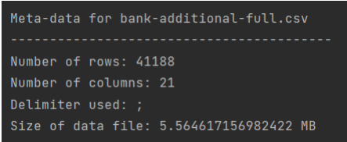
Data Understanding
The dataset chosen for further analysis and for ML model creation will be bank-additional-full.csv because it seems to be ideal for the purpose of this project since it is more recent and has more variables, which helps us to build an efficient model.
In this stage the main objective includes cleaning the data, dealing with missing and unknown values, reducing data dimensionality, transforming data values, and sometimes reformatting the data to suite the desired mining solution. Other operations performed under this stage includes data aggregation, normalisation, and attribute creation i.e., making new variables to tackle specific business queries.

Slide 7

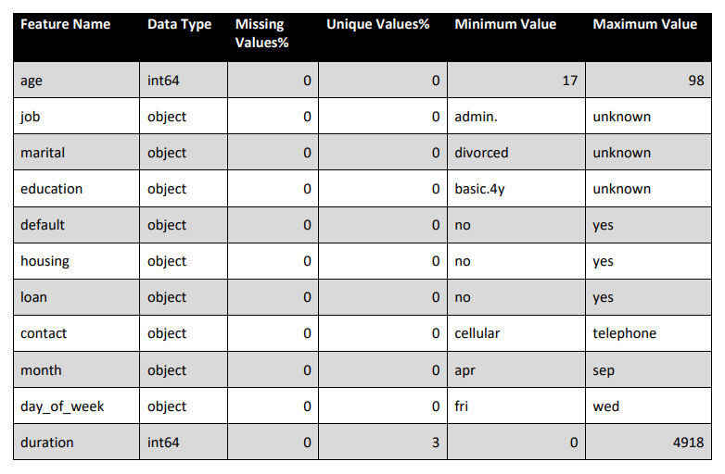
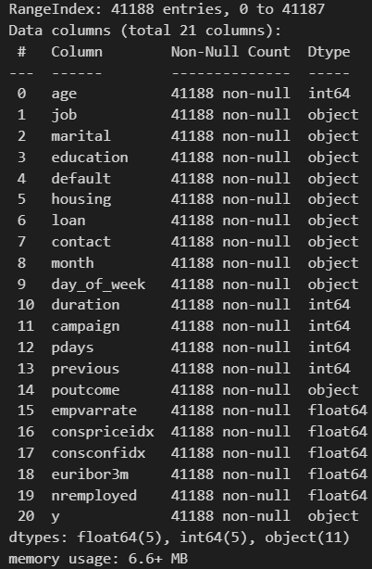
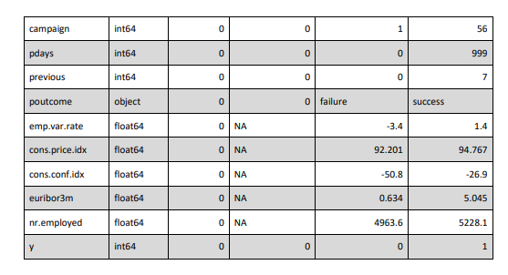
Below images display the meta-data of the data that we will be using along with the meta-data of it’s attributes.

Slide 8

Data Preparation
Outliers removed from original data set
Cleaned Data:
bank-additional-full data set
Duplicates removed from the original data set
Missing values, unknown values dealt with and removed from the data set.

Slide 9

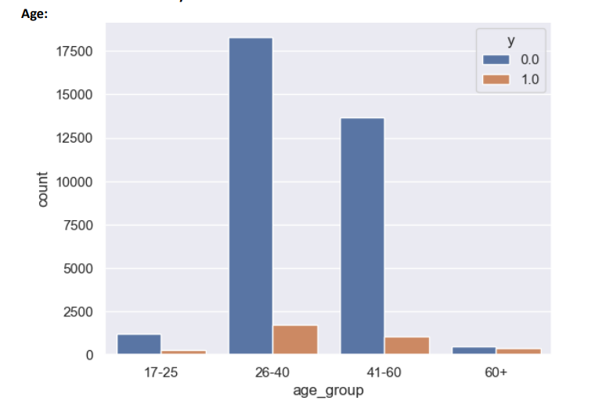
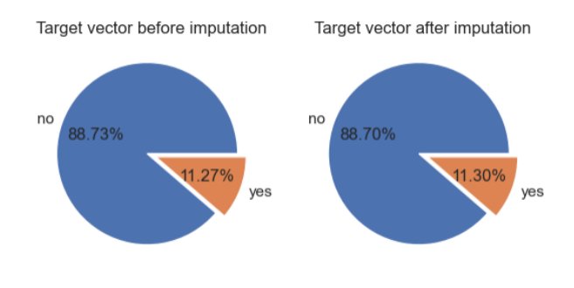
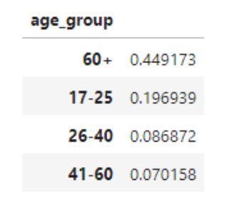
Target vector share before and after Imputation

Slide 10
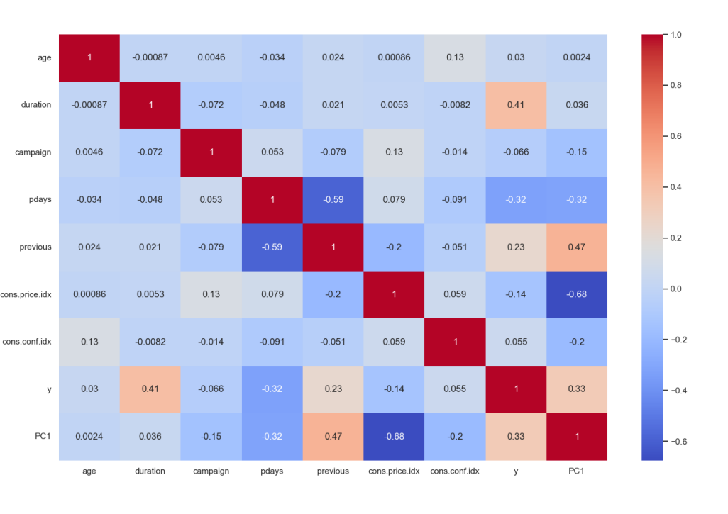
Correlation between features
Data Preparation-EDA of Features
After transforming the three highly correlated features into one feature using PCA, the below image shows the heatmap of the Pearson’s Correlation matrix of the updated dataframe. It is evident from the similar correlation value between the new feature PC1 and y that the correlation problem has been solved without losing the information contained in the features

Slide 11
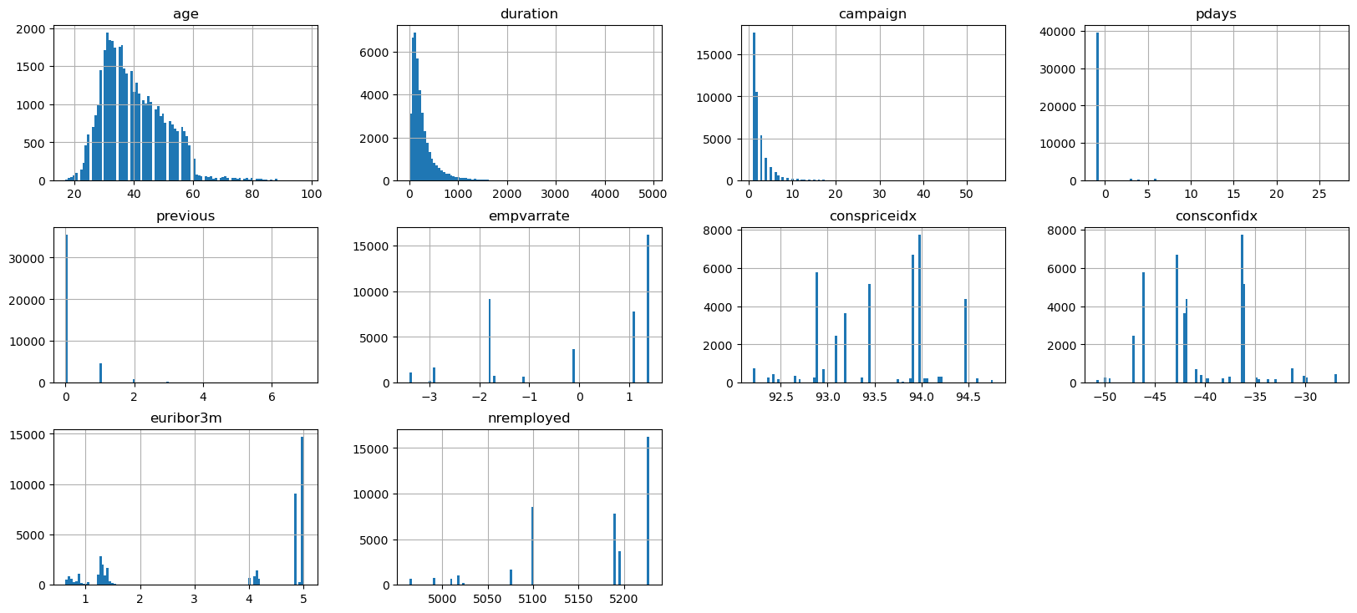
Analysis of Outliners
Data Preparation-EDA of Numerical Features
For the ‘pdays’ column, it was found that the outliers were due to 999 placeholder values for missing data. We reencode them as -1.
The boxplots reveal that majority of the outliers were successfully remove

Slide 12
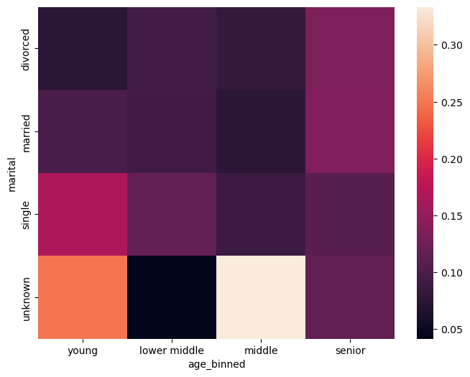
Data Preparation-EDA of Population Groups
We divide age into four groups from young to senior based on quantiles. The heatmap for each age groups corresponding with marital condition is shown. Among known marital data, single young, senior married has the most proportion.

Slide 13
Data Modelling
Model Evaluation plays a crucial role in the model development process, where it helps to find the best model that fit and represents the data set in question. These models are assessed based on their performance.
Data mining is an iterative process; hence the generated modelling results should be evaluated against the business objectives, and sometimes should the accuracy of the mining model be poor, the whole mining process needs to be revisited starting from the business point and understanding of the data.
We will be using a set of evaluation metrics to assist in the process of accessing the performance of these classifiers.
Accuracy
Precision
F1 Score
AUC-ROC

Slide 14
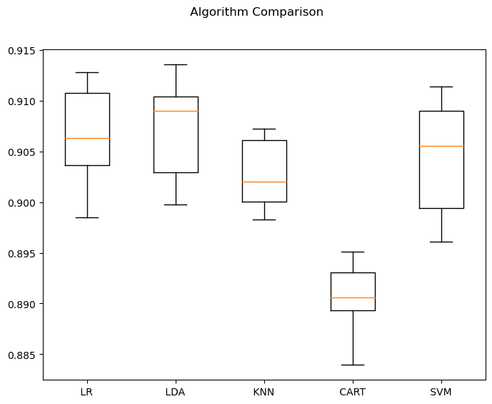
Recommended Models
We have 8 categorical Variables and 7 numeric variables in the data after cleaning the data.
Model Chosen includes Logistic Regression, KNN, Decision Tree, and SVM. Doing a 10-fold cross validation training, the accuracy score for each model is recorded:

Slide 15
Recommended Models
Logistic Regression and SVM is in favoured with an average accuracy score of 0.91
With fine tuning, Logistic Regression is out final recommended model with parameters set as num_iters = 3000, learning rate = 0.01, penalty = L2, C = 2 and average accuracy score of 0.94.
Q & A

